Slide 1
Machine-Level Programming I: Basics

Slide 2
Machine Programming I: Basics
History of Intel processors and architectures
C, assembly, machine code
Assembly Basics: Registers, operands, move
Arithmetic & logical operations

Slide 3
Intel x86 Processors
Dominate laptop/desktop/server market
Evolutionary design
Backwards compatible up until 8086, introduced in 1978
Added more features as time goes on
Complex instruction set computer (CISC)
Many different instructions with many different formats
But, only small subset encountered with Linux programs
Hard to match performance of Reduced Instruction Set Computers (RISC)
But, Intel has done just that!
In terms of speed. Less so for low power.

Slide 4
Intel x86 Evolution: Milestones
Name Date Transistors MHz
8086 1978 29K 5-10
First 16-bit Intel processor. Basis for IBM PC & DOS
1MB address space
386 1985 275K 16-33
First 32 bit Intel processor , referred to as IA32
Added “flat addressing”, capable of running Unix
Pentium 4E 2004 125M 2800-3800
First 64-bit Intel x86 processor, referred to as x86-64
Core 2 2006 291M 1060-3500
First multi-core Intel processor
Core i7 2008 731M 1700-3900
Four cores; likely what your laptops or desktops are running.

Slide 5
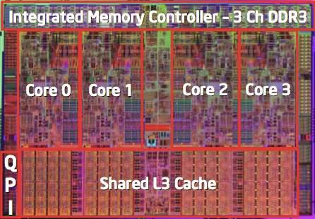
Intel x86 Processors, cont.
Machine Evolution
386 1985 0.3M
Pentium 1993 3.1M
Pentium/MMX 1997 4.5M
PentiumPro 1995 6.5M
Pentium III 1999 8.2M
Pentium 4 2001 42M
Core 2 Duo 2006 291M
Core i7 2008 731M
Added Features
Instructions to support multimedia operations
Instructions to enable more efficient conditional operations
Transition from 32 bits to 64 bits
More cores

Slide 6
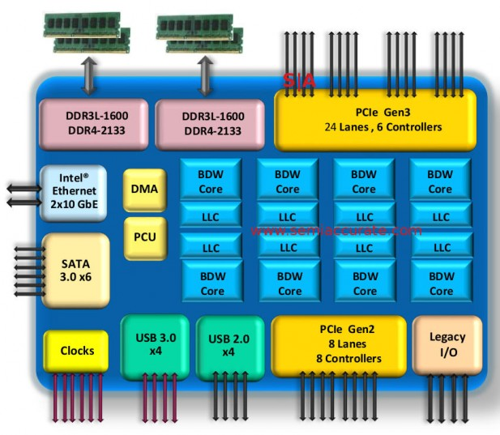
2015 State of the Art
Core i7 Broadwell 2015
Desktop Model
4 cores
Integrated graphics
3.3-3.8 GHz
65W
Server Model
8 cores
Integrated I/O
2-2.6 GHz
45W

Slide 7
x86 Clones: Advanced Micro Devices (AMD)
Historically
AMD has followed just behind Intel
A little bit slower, a lot cheaper
Then
Recruited top circuit designers from Digital Equipment Corp. and other downward trending companies
Built Opteron: tough competitor to Pentium 4
Developed x86-64, their own extension to 64 bits
Recent Years
Intel got its act together
Leads the world in semiconductor technology
AMD has fallen behind
Relies on external semiconductor manufacturer

Slide 8
Intel’s 64-Bit History
2001: Intel Attempts Radical Shift from IA32 to IA64
Totally different architecture (Itanium)
Executes IA32 code only as legacy
Performance disappointing
2003: AMD Steps in with Evolutionary Solution
x86-64 (now called “AMD64”)
Intel Felt Obligated to Focus on IA64
Hard to admit mistake or that AMD is better
2004: Intel Announces EM64T extension to IA32
Extended Memory 64-bit Technology
Almost identical to x86-64!
All but low-end x86 processors support x86-64
But, lots of code still runs in 32-bit mode

